Slide 1
Faculty Syllabus Training
Regulation on Publication of Academic Calendars, Grading Policies, and Related Materials
Notes:
Welcome to the Faculty Syllabus Training. Today, we are discussing the regulation from the UNC System, 400.1.6- Regulation on Publication of Academic Calendars, Grading Policies, and Related Materials.

Slide 2
UNC Syllabus Policy 400.1.6
Regulation on Publication of Academic Calendars, Grading Policies, and Related Material
Syllabus Defined:
A. “Syllabus” or “Syllabi” is defined in this regulation as an employer required document to accompany any course offered by an institution for academic credit. Syllabi are developed by the instructor, at the institution’s direction, and are required to include sufficient detail to inform students of the course and instructor’s expectations for the specified class.
B. Directed Works. Syllabi are directed works^{[2]}, as distinguished from creative non-directed works, that are developed within the scope of an instructor’s employment and under institutional direction. Under section XII of Section 500.2 of the UNC Policy Manual, Patent and Copyright Policies, the institution is considered the copyright owner of course syllabi, as directed work.^{[3]} As such, instructors do not retain personal copyright in these materials, and syllabi owned by a public agency generated in the course of public business, are not copyrightable in a manner that would exempt syllabi from public access to these records, consistent with state and federal public records laws. Syllabi shall be treated as “public records” as that term is used in Chapter 132 of the North Carolina General Statutes.
Notes:
This policy essentially standarizes how course syllabi information is shared at the institutional level across all of our system institutions.
In December 2025, UNC System adopted this regulation to include 3 parts. First, the regulation states that the Syllabus is a directed work of the university and shall be treated as public records in accordance with Chapter 132 of of the General Statutes. This wasn’t a significant shift for App State as we were in many ways already treating them as public records when reading along with our Copyright policy.

Slide 3
Syllabi Content
Beginning in the 2026-27 academic year, all syllabi shall, at a minimum, include the following:
1. Course name and prefix, along with the course description;
2. All goals, objectives, student learning outcomes, and/or student expectations for the course;
An explanation of how student performance will be assessed, including the grading scale, percentage
breakdown of major assignments, and how attendance or participation will affect a student’s final grade;
4. List of all course materials (physical and/or electronic) that students are required to purchase; and
A statement noting that the course engages diverse scholarly perspectives to develop critical thinking,
analysis, and debate and inclusion of a reading does not imply endorsement.
Syllabi do not constitute an express or implied contract among the student, faculty, or institution.
Rather, syllabi serve as a guide for the course.
Notes:
Second, the regulation defines what a syllabus at a minimum contains
Course name, prefix, and description
Goals, objectives, student learning outcomes, and/or student expectations
An explanation of student performance assessment (grading scale, assignment breakdown, and attendance/participation policies)
A list of all course materials (digital or physical) that students are required to purchase (which includes textbooks assigned via App State’s textbook rental program)
Statement on diverse scholarly perspectives

Slide 4
Availability of Syllabi
Beginning in the 2026-27 academic year, each instructor teaching a course offered by an institution for academic credit shall establish and maintain a course syllabus to properly define the expectations of the course and include information required in this regulation. Academic experiences occurring outside of organized course sections and providing individual instruction in exchange for course credit, e.g. practicums, internships, independent research, and dissertations, may not require a syllabus.
Syllabi will be available and housed on an online platform for each course offered in a given semester or session.
Syllabi will be searchable to the public.
All course syllabi shall be posted to the institution’s publicly available online platform no later than one (1) week prior to the first day of classes for the applicable semester or session:
Notes:
Third, it outlines the requirements for a public online forum and the timeline for posting that information.
Side Note: Whenever the UNC System sets a compliance deadline, the institution set deadlines to ensure compliance by the System Deadline. With that approach, we will end up with a deadline “in the summer”. Because this is our first year, we wanted to allow plenty of time to troubleshoot any issues going into the System Deadline. I was also trying to allow an opportunity for faculty who wanted to get it done before the middle of May to do that, and for faculty who wanted additional time to have that as well. We recognize the institutional Deadline of July 1 is atypical and we will continue to work to discuss these timelines.

Slide 5
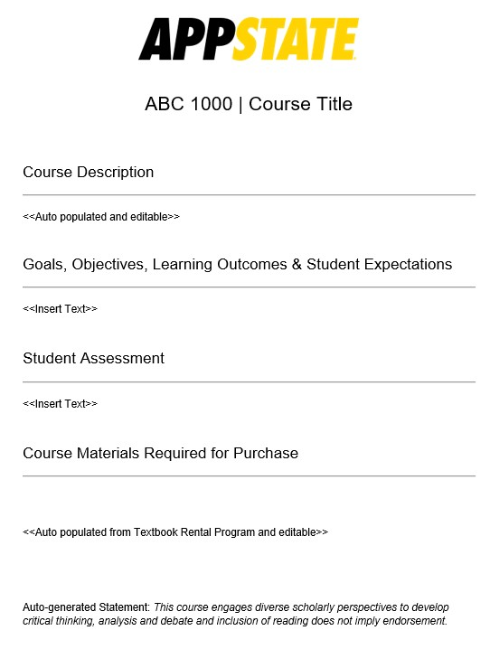
How to Submit Course Syllabi
Write up syllabus content
  Auto-populated fields
    Course Description
    Statement Regarding Endorsement
    Textbook Rental Materials*
Email→Link to Qualtrics form from IRAP
Insert content into fields
Submit
Notes:
App State is utilizing a Qualtrics base system for all submissions similar to what we use for Faculty Workload plans. You will receive a direct link to this Qualtrics form via your university email. To save you time, the system is designed to automatically pre-populate the Course Description, Statement Regarding Endorsement, as well as Textbooks made available through the textbook rental program so you may focus on the unique details of your specific course in the other fields. Let’s walk through the steps for entering your data into the system
Write up your syllabus information, a template is available on the Academic Affairs website

Slide 6
Syllabi Content
Beginning in the 2026-27 academic year, all syllabi shall, at a minimum, include the following:
Prepopulated & Editable
1. Course name and prefix, along with the course description;
All goals, objectives, student learning outcomes, and/or
student expectations for the course;
        An explanation of how student performance will be
        assessed, including the grading scale, percentage breakdown
        of major assignments, and how attendance or participation
        will affect a student’s final grade;
List of all course materials (physical and/or electronic) that
students are required to purchase; and
A statement noting that the course engages diverse scholarly
perspectives to develop critical thinking, analysis, and debate and
inclusion of a reading does not imply endorsement.
Completed by instructor
Prepopulated & Editable
Prepopulated & Cannot Edit
Notes:
The fields in Qualtrics are a combination of prepopulated and non prepopulated:
Course name, prefix, and description: Prepopulated when available from the current Academic Bulletin. You may edit the description if needed.
Goals, objectives, student learning outcomes, and/or student expectations: To be completed by the instructor.
An explanation of student performance assessment (grading scale, assignment breakdown, and attendance/participation policies): To be completed by the instructor.
A list of all course materials (digital or physical) that students are required to purchase and textbooks assigned via App State’s textbook rental program: An effort has been made to prepopulate the information with course materials, but this requires your review and may not be complete. Please review, add, update, and/or correct.
Statement on diverse scholarly perspectives: This statement is prepopulated and cannot be edited.

Slide 7
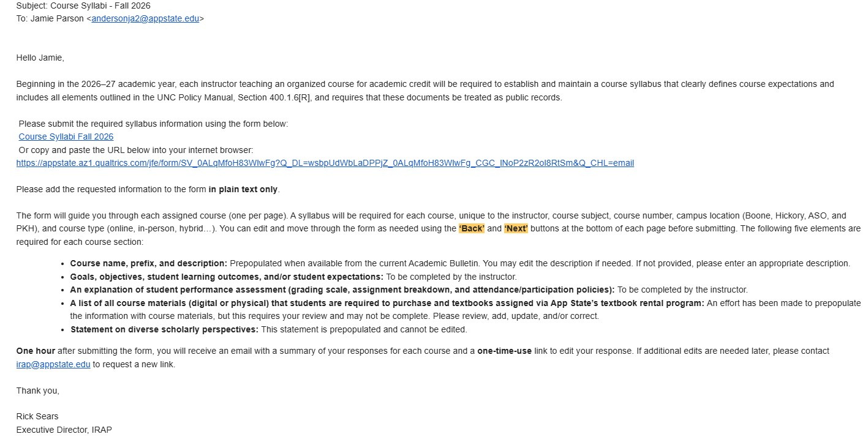
How to Submit Course Syllabi
Write up syllabus content
Email→Link to Qualtrics form from IRAP
Insert content into fields
Submit
Notes:
In your email, you will receive a link requesting you to submit the required syllabus information.

Slide 8
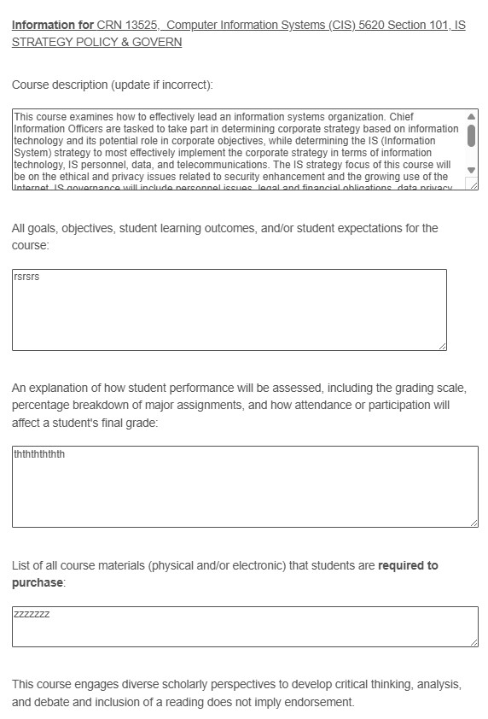
How to Submit Course Syllabi
Write up syllabus information
Email→Link to Qualtrics form
Insert content into fields
Submit
Notes:
Insert the requested information from your syllabus into the form in plain text only (think notepad)
The form will guide you through each assigned course (one per page). A syllabus will be required for each course, unique to the instructor, course subject, course number, campus location (Boone, Hickory, ASO, and PKH), and course type (online, in-person, hybrid…).

Slide 9
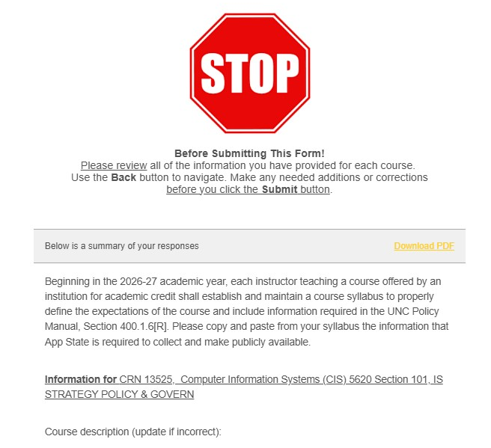
How to Submit Course Syllabi
Write up syllabus information
Email→Link to Qualtrics form
Insert content into fields
Submit
Notes:
There are two places where you can download a copy of your syllabus submission. One at the end of your entry before your submit and then again when you receive the confirmation email.
After submitting the form, you will receive an email with a summary of your responses for each course and a one-time-use link to edit your response. If additional edits are needed later, please contact irap@appstate.edu to request a new link. Please note that it will generally take up to one hour to receive your email confirmation.

Slide 10
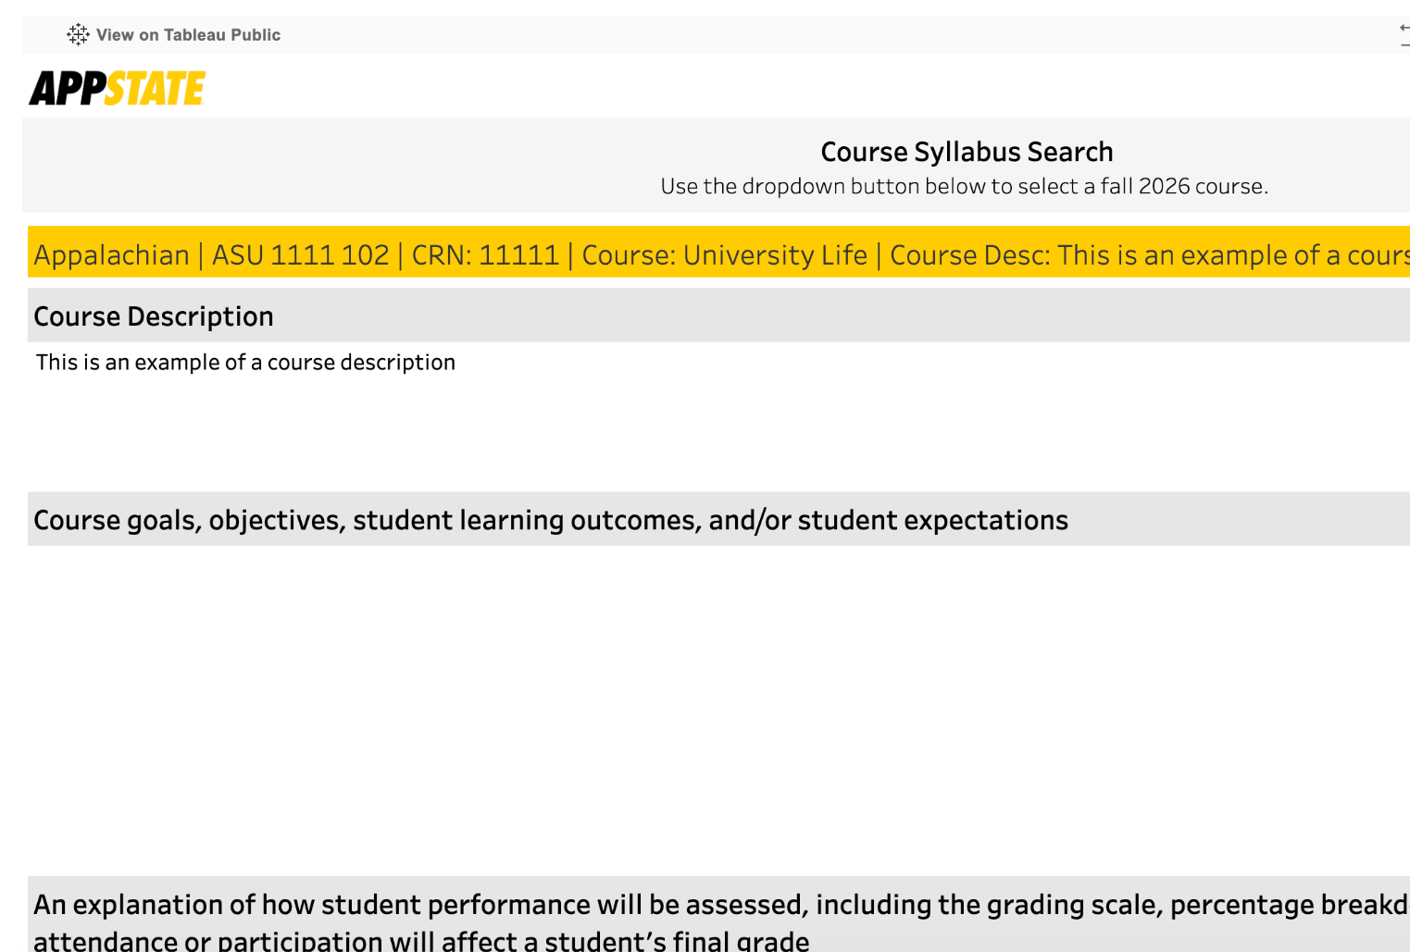
Public Facing Platform
Aims to aid student success by enabling informed course selection
Will serve as the repository for syllabi vs. department level maintenance for accreditation purposes
Notes:
Once the data is entered it will go into this public facing portal
Premise of the policy is to aid in student success by enabling informed course selection
It will also serve as the formal repository for syllabi so department level maintenance for accrediation purposes is no longer needed (yay for the dept admin)

Slide 11

Additional Guidance
Use Microsoft Word for template
Review organization with students
All documents called Syllabus/Syllabi are likely subject to the records requests
Notes:
When developing the content for your syllabus, I recommend using Microsoft Word vs a Google Doc as the formatting doesn’t translate from Google Docs in the same way it does for Microsoft Word.
As this policy reshapes this one stop shop approach to course materials, take time at the beginning of your class to show students where they can find the information they need to be successful in class
All documents called a syllabus/syllabi are likely subject to records request
Still talking through a solution on the Canvas site (not as easy as turning off or changing the name of the field)

Slide 12
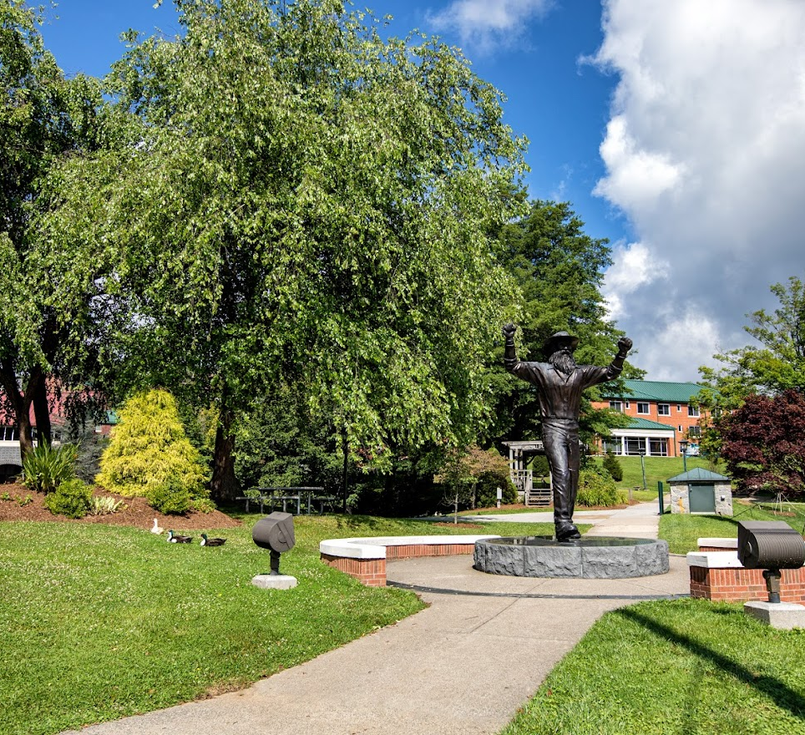
Canvas
Please post your course syllabus in the Qualtrics system, Appalachian State University's online platform used to make syllabi readily searchable to the public in accordance with Section 400.1.6[R] of the UNC Policy Manual. Any and all material uploaded into this "Course Syllabus" section shall be considered directed works and treated as "public records" as that term is used in Chapter 132 of the North Carolina General Statutes.
Notes:
Canvas Syllabus setting will be defaulted off with the following disclosure should you elect to turn it on.

Slide 13

Additional Guidance
Material Changes
If you use alternative grading systems and need assistance, contact CETLSS
Notes:
When you make a material change to your syllabus, please update it on the site.
If you use an alternative grading system such a specifications grading and need assistance on how to put that into the box, reach out to CETLSS

Slide 14


Need Assistance?
CETLSS
IRAP

Slide 15
Contact Us
Academic Affairs
(828) 262-2070
aa@appstate.edu
www.academicaffairs.appstate.edu

Slide 16
Q & A

