Slide 1

Faculty Post Tenure Review (PTR) Submission with InfoReady

Slide 2
Why InfoReady?
What is InfoReady?
InfoReady is an all-in-one platform for higher education submission and approval processes for selected faculty actions.
InfoReady allows faculty members to upload their PTR materials and automatically routes to the appropriate approver(s) for review.
For consistency and efficiency in Post Tenure Review (PTR) processes across all colleges/units
The process begins with faculty members submitting their required materials to the Department Chair or Designee* for review, then the materials are routed to the College/Unit Dean for review and approval.
*Designee for units without Department Chairs

Slide 3
Post Tenure Review (PTR) Process & Timeline – Academic Year: 2025-2026
Date(s) | Action/Materials
Before March 2nd | PTR Committee orientation meeting with Department Chair
By Monday, March 2nd | Faculty member submits materials to the Department Chair in InfoReady
March 2nd– April 6th | PTR Committee meets as appropriate
By April 7th | PTR Committee summary due to faculty member and Department Chairperson or Designee* (this step is not in InfoReady)
By April 28th | Department Chair Evaluation / Recommendation, along with required documents
By May 18th | Dean Evaluation / Recommendation
By May 29th | Provost Evaluation / Recommendation – only submitted for PTRs with overall rating of Exceeds Expectations with rank of Professor
*Designee for units without Department Chairs

Slide 4
Post Tenure Review (PTR) Submission Materials:
- a self-assessment narrative that summarizes the faculty member’s accomplishments over the previous five (5) years
- a current curriculum vita
- the faculty member’s long-term, 5-year work plan with any noted updates to the plan
since its creation; which may include: evidence of teaching effectiveness, student feedback, peer reviews of teaching, professional development specific to improving teaching
- copies of each annual review for the past 5 years (provided by faculty member or Department Chair)

Slide 5
Summary of the Submission Process (1 of 2)
Step 1 | Step 2 | Step 3 | Step 4 | Step 5
Faculty member submits the Post Tenure Review (PTR) materials through InfoReady | Department Chair is notified by email ‘Request to Review’ | Department Chair or Designee shares packet with PTR Chair & Committee | After the PTR meeting and vote, the Department Chair or Designee uploads: 1) PTR Committee Summary 2) Faculty Member's Right to Respond (if submitted to the Department Chair) 3) Copies of the last five annual reviews (if not provided by faculty member) 4) Five-year goals/plan (if not provided by faculty member) 5) Department Chair recommendation letter | College Admin and Dean are notified by email ‘Request to Review’

Slide 6
Summary of the Submission Process (2 or 2)
Step 6 | Step 7 | Step 8 | Step 9 | Step 10
College Admins review the submissions and if any required documents are missing, request them from the faculty member or Department Chair. | Once the submission has been reviewed by the College Admin and Dean, the Admin will upload any missing documents and the Dean’s recommendation letter into InfoReady | College Dean reviews materials and provides a recommendation letter to the College Admin. The College Dean’s review will acknowledge review of the submission and choose a performance rating. | Once all reviews have been completed, Academic Affairs will review submissions with the overall rating of Exceeds Expectations (EE). | Faculty Handbook: Provost Evaluation/Recommendation 3.11.9 - Based on the review, faculty members with the rank of professor will be considered for a reward for exemplary service.

Slide 7
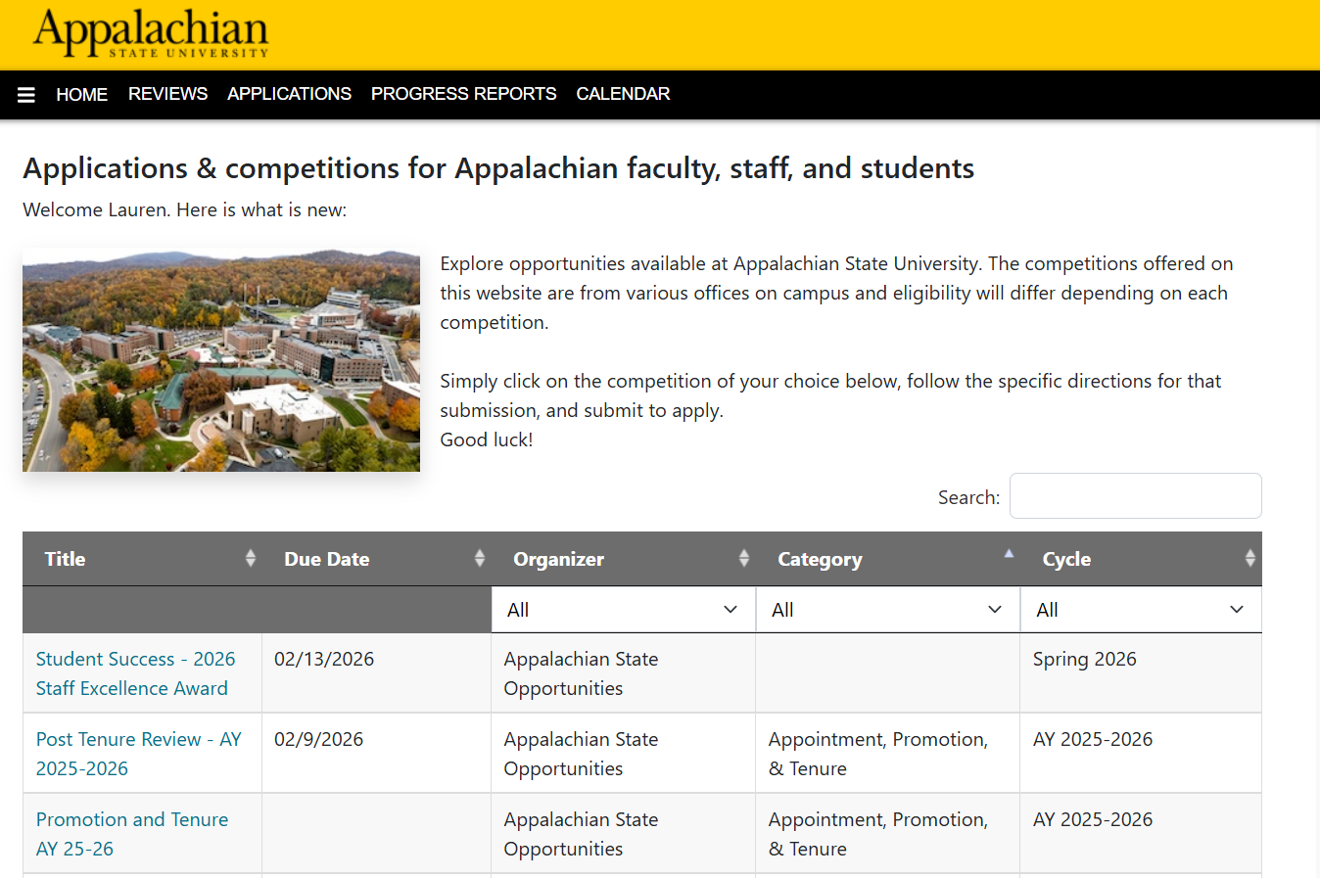
How to Submit Materials in InfoReady
Post Tenure Review Submission Video
        No audio but visually represents the submission portal and materials needed. Access the Google Doc that provides a description of the information in the video.
        While working on your submission you can ‘Save as Draft’ or ‘Submit.’

Slide 8
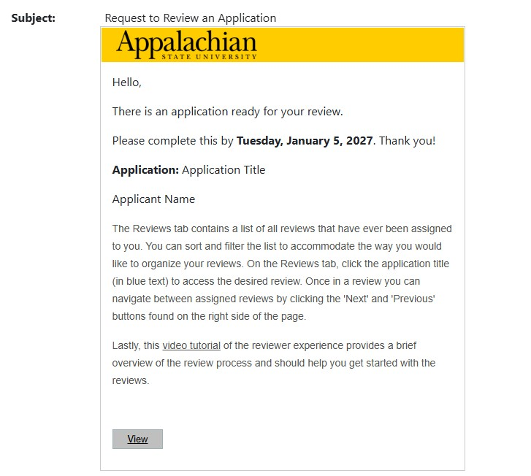
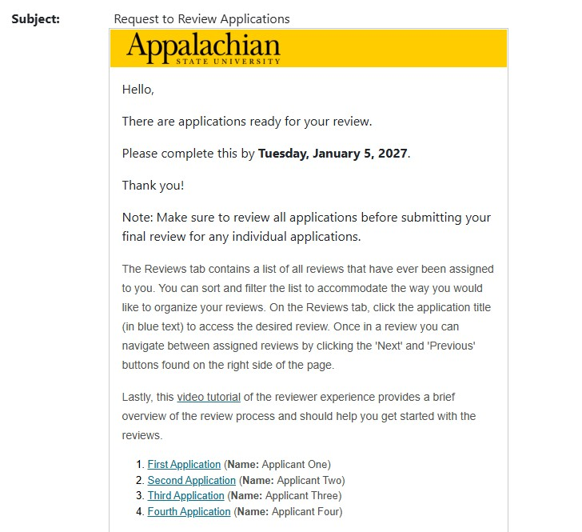
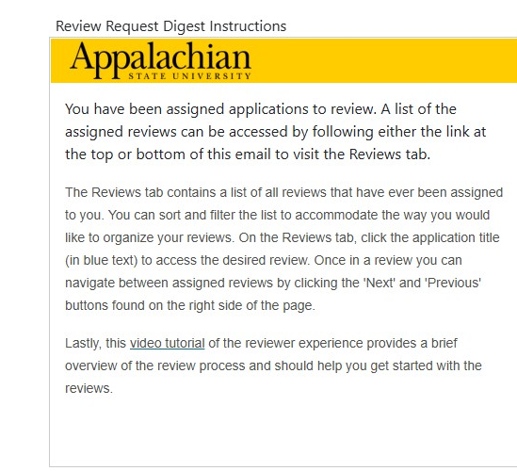
Email Notifications for Review & Recommendation
Request to review one submission
Request to review multiple submissions
Request Digest with instructions
Notifications will be emailed to Department Chairs, College Admins, & Deans once faculty members submit their Post Tenure Review Materials

Slide 9
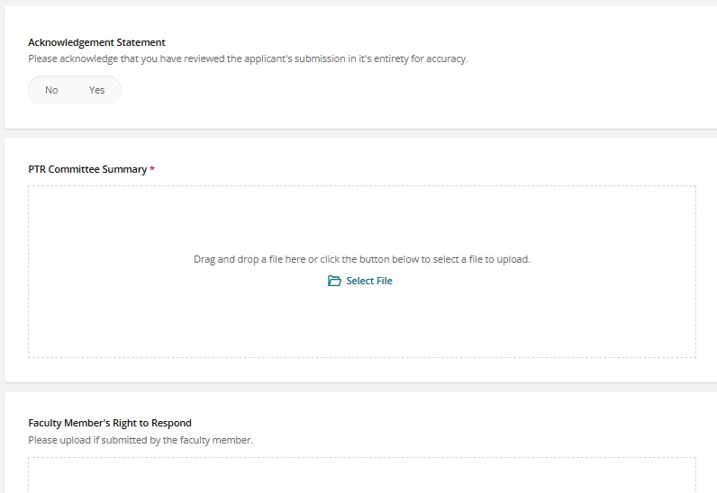
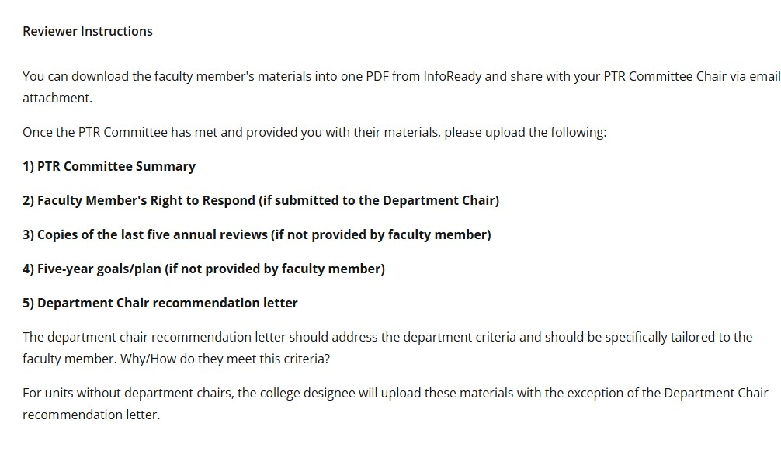
Department Chair Review & Uploads
Department Chairs or Designee will choose yes or no to acknowledge the review of materials and upload the appropriate materials needed for the faculty member.

Slide 10
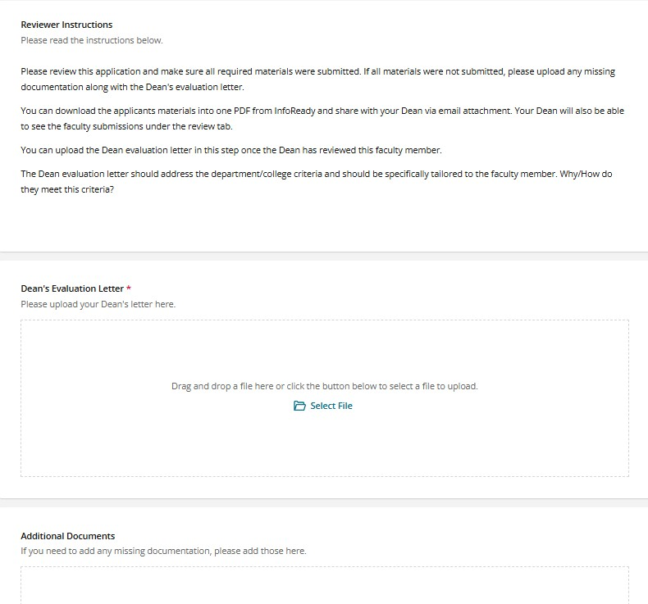
College Admin Review & Uploads
The College Admin will review the submission packet to ensure all materials are included and if not, they have the opportunity to upload missing documentation.
The College Admin will upload the Deans Evaluation / Recommendation letter once the Dean has reviewed the materials

Slide 11
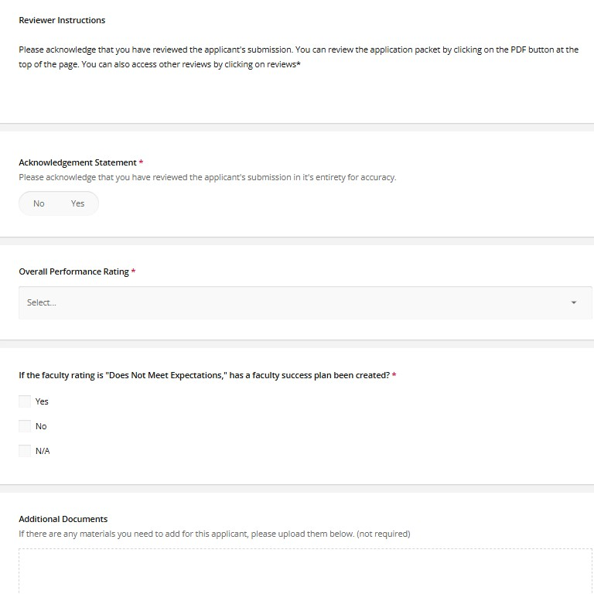
Dean Review & Uploads
The Dean will choose Yes or No to acknowledge the review of the submission.
The Dean will select the overall performance rating based on their review of materials.
If the faculty member’s rating is ‘Does Not Meet Expectations,’ they need to choose whether a faculty success plan has been created.
If there need to be any additional documents added, the Dean also has an upload option. (not required)

Slide 12
3.11.9 Provost Evaluation/Recommendation. Those faculty members who receive an overall ranking of Exceeds Expectations from their Dean shall have their materials forward to the Provost and Executive Vice Chancellor. Based on the review, faculty members with the rank of professor will be considered for a reward for exemplary service.
Next Steps
Those faculty with rank of Professor with an overall Exceeds Expectations will receive notification from the Provost’s Office by the beginning of June.

Slide 13
Contact Us
Academic Affairs
(828) 262-2070
www.academicaffairs.appstate.edu

