Slide 1
Faculty Promotion and Tenure Submission with
InfoReady

Slide 2
What is InfoReady?
InfoReady
The all-in-one platform for higher education’s selection and approval processes
Submission
Faculty submit their application through InfoReady
How will this help or change the submission process?
Review & Approval
Review, upload recommendations, & submit to Dean

Slide 3
Summary of the Submission Process
Step 1
Step 2
Step 3
Step 4
Step 5
Faculty member submits application through InfoReady
*The collection of Artifacts/Documentation should be submitted separately to the Department Chair (or Dean if applicable) for review
Department Chair is notified by email ‘Request to Review’
Department Chair (or Dean) shares packet with APT chair & committee
Chair uploads APT Recom. letter, Vote Justification Forms, & Chair Recom. Letter, in InfoReady
College Admin and Dean are notified by email ‘Request to Review’

Slide 4
Summary of the Submission Process…Continued
*Step 6
*Step 7
*Step 8
Step 9
Step 10
College Admins review the submissions and if any required documents are missing, request them from the faculty member or Department Chair.
Once the submission has been reviewed by the College Admin and Dean, the Admin will upload any missing documents and the Dean’s recommendation letter into InfoReady.
College Dean reviews materials and provides a recommendation letter to their Admin. The College Dean’s review will have an option to Approve or Not Approve the application.
Once all reviews have been completed, Academic Affairs will have all materials in InfoReady for the next level of approval. College Admins will need to complete the ‘Summary of Recommendation Action Sheets’ and email to Lauren Davis and the Senior Vice Provost.
The Senior Vice Provost and Provost review faculty submissions for approval.
Approved materials will be submitted to the Board of Trustees for approval during their annual March meeting.
* = These steps are happening at the same time.

Slide 5
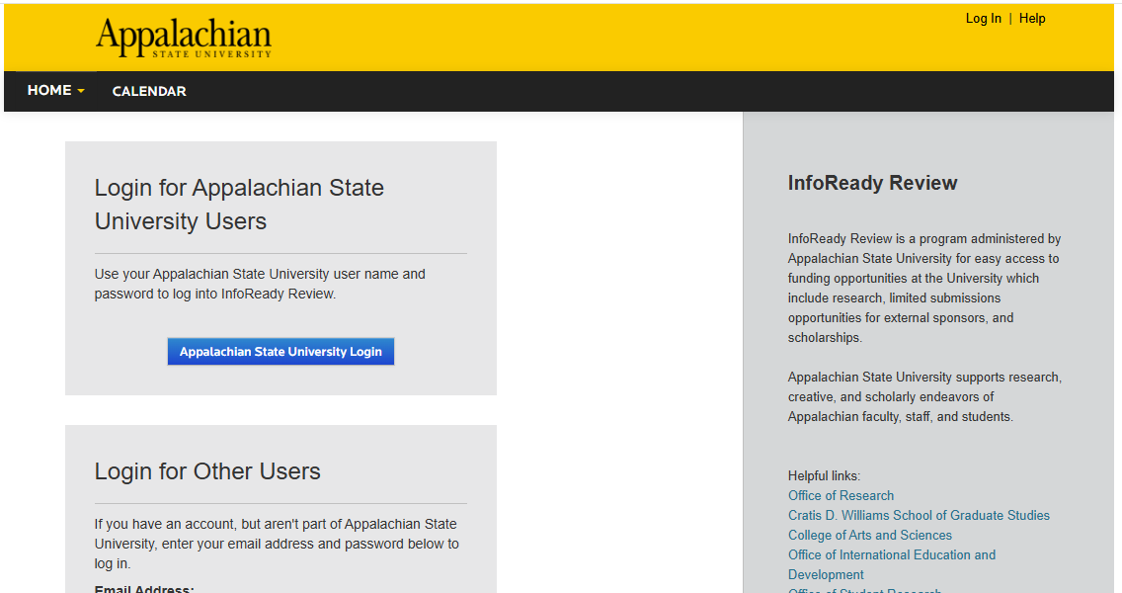
How does a faculty member apply for
promotion and tenure?
Login to InfoReady:
Link provided on the Academic Affairs Resources & Forms page
Link also provided in the Academic Affairs Standard Operating Procedures (AASOPs)
Sign in using your AppState credentials
Notes:
https://appstate.infoready4.com/#apt

Slide 6
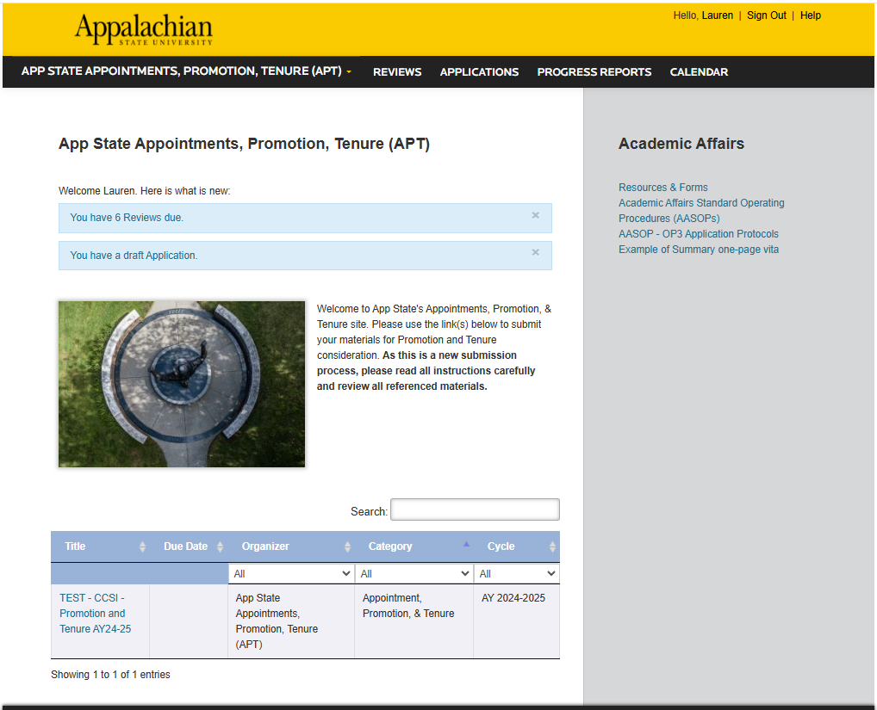
The Application process in InfoReady
If you have reviews to complete or an application submitted, you will see them in blue.
To apply, click on Promotion & Tenure AY 25-26
Notes:
Make sure and take note of the available submission below and the additional resources in the grey sidebar.

Slide 7
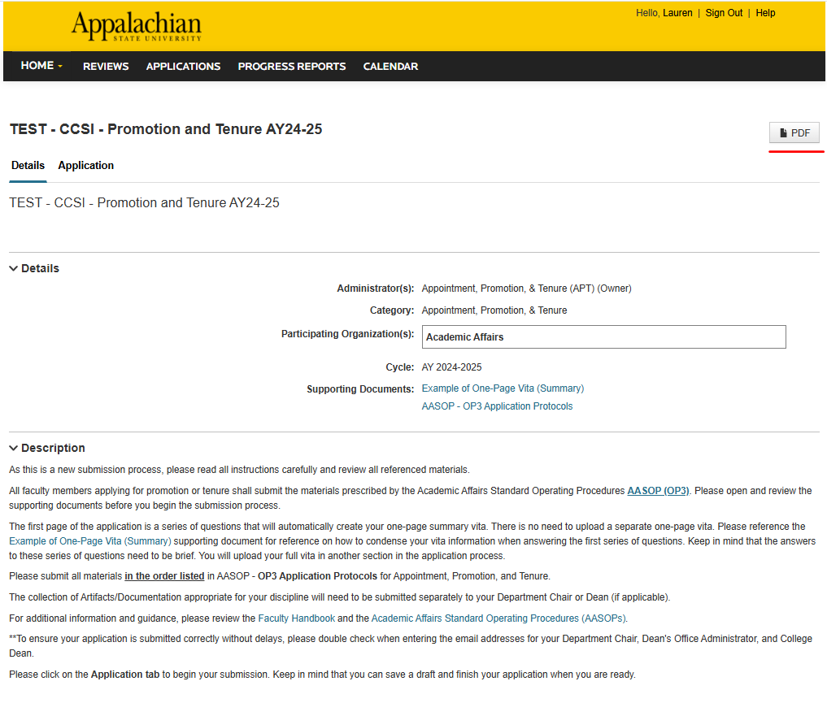
Make sure faculty members review the description of the submission process. This area also provides links to the Faculty Handbook, Academic Affairs Standard Operating Procedures (AASOPs), and an example of a one-page summary vita.
Clicking the PDF will open the supporting documents listed.

Slide 8
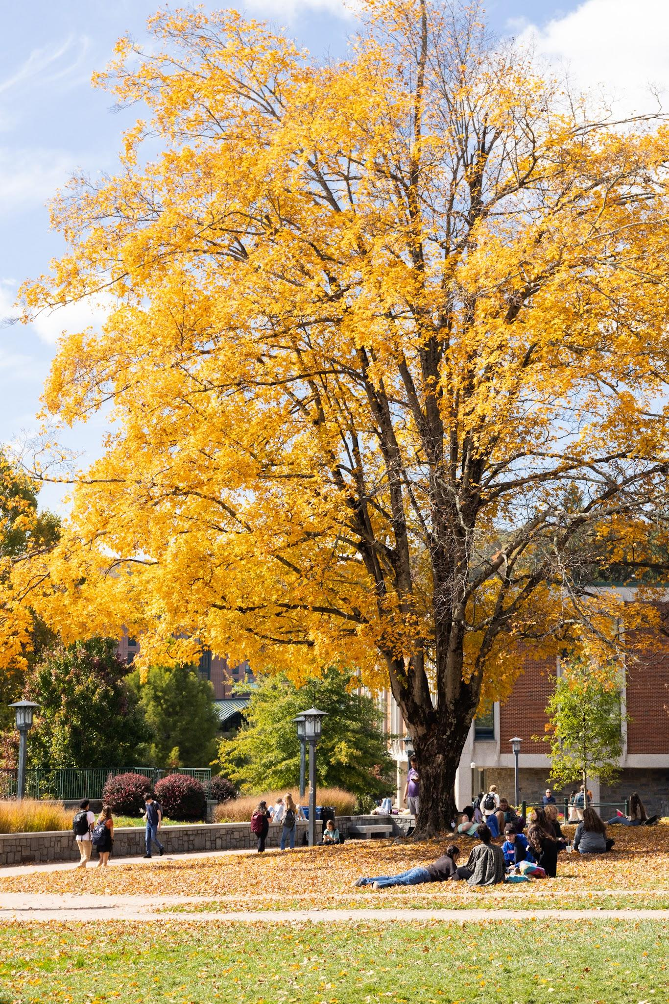
Helpful tips when completing page 1 of the application submission:
It is helpful to use the one-page summary vita as a template and guide when completing the 1st page of the application. You can print it out or even enter your information in the template to ensure you do not go over the one-page limit
You can ‘Save as Draft’ if you need more time to compile your supporting documents
Once you submit your application, you cannot edit. You will need to contact your Department Chair or Dean and ask that the application be deleted and you will need to reapply.

Slide 9
Faculty member submission process video
Notes:
https://appstate.infoready4.com/#apt

Slide 10
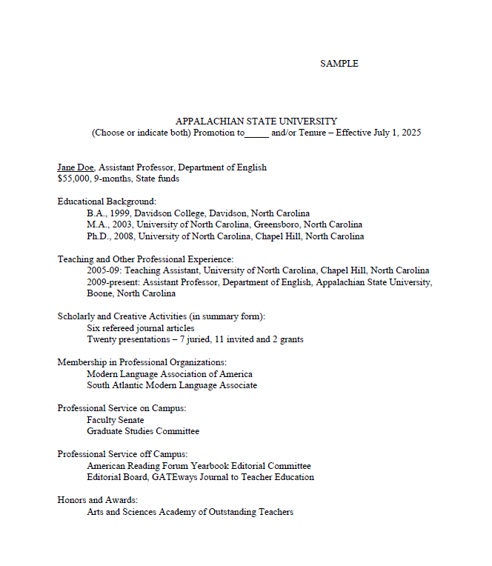
You will notice that the application questions on the first page mimic a one-page summary vita.
Faculty members will not have to submit two versions of the one-page summary vita.
By answering these questions, in summary form, the vita is created automatically!

Slide 11
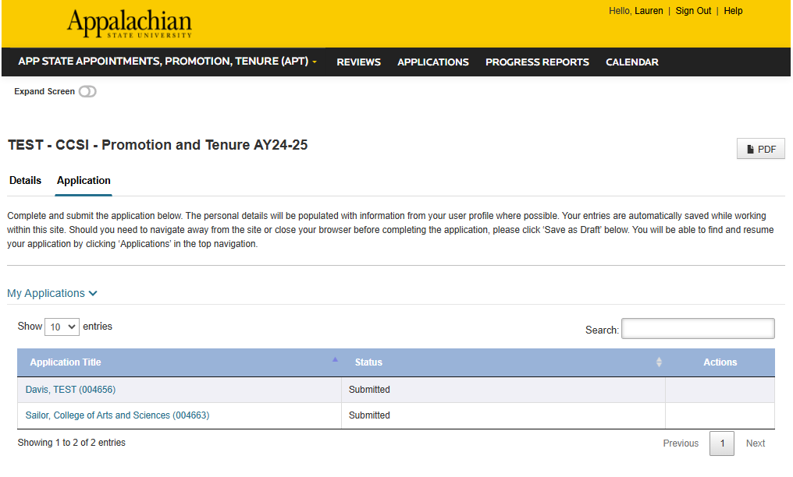
If faculty members want a copy of their submission, they can click on the PDF button and download their submission.

Slide 12
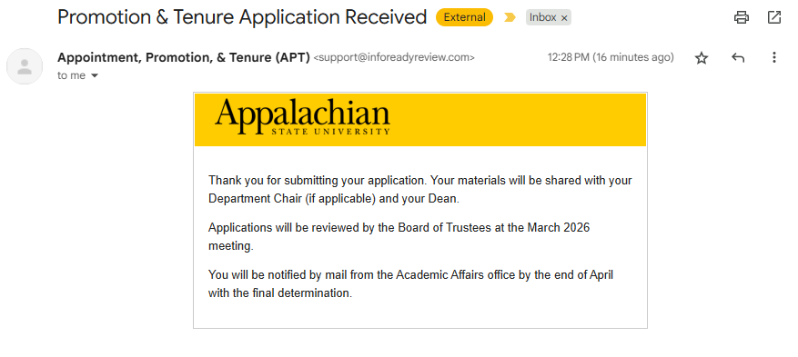
Email notification to the faculty member after submission:

Slide 13
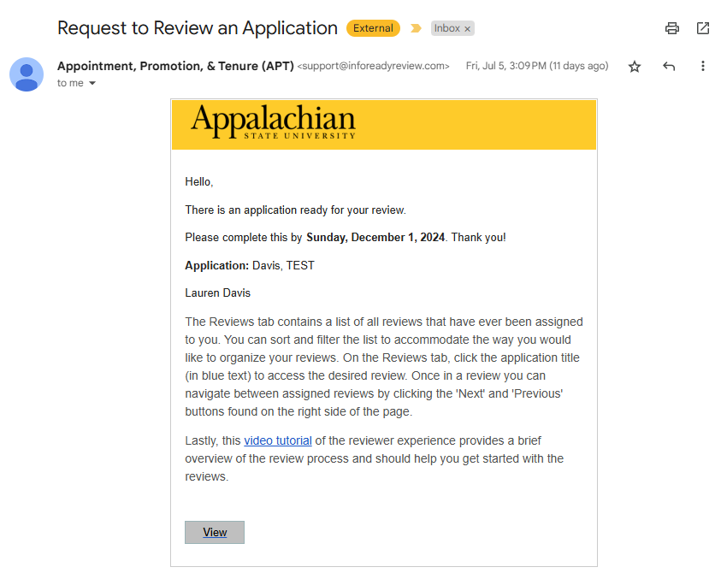
Department Chair email notification

Slide 14
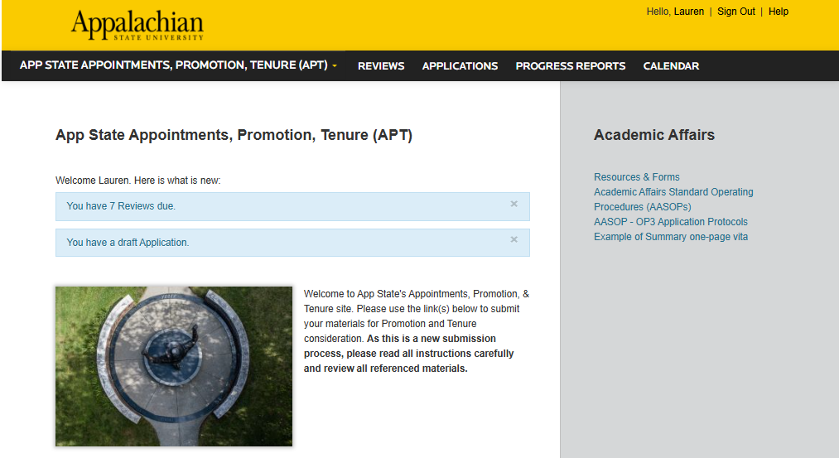
Department Chair Review Process
Login to InfoReady using your AppState Credentials
Click on the box noting that you have reviews due or click on the Reviews heading at the top of the page in black

Slide 15
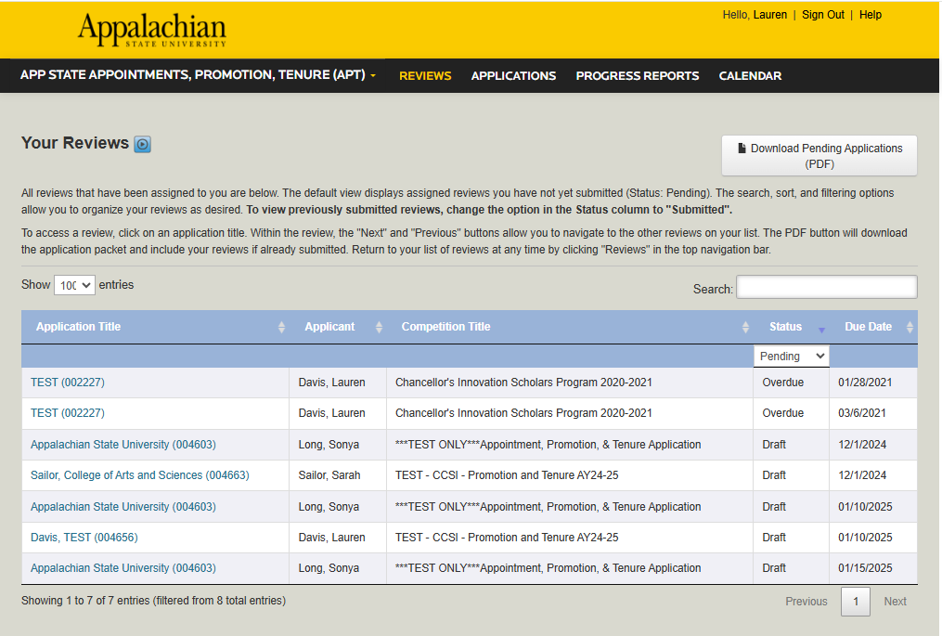
Department Chair Review Process
Click on the application to open the individual submission or you can download applications (not recommended).

Slide 16
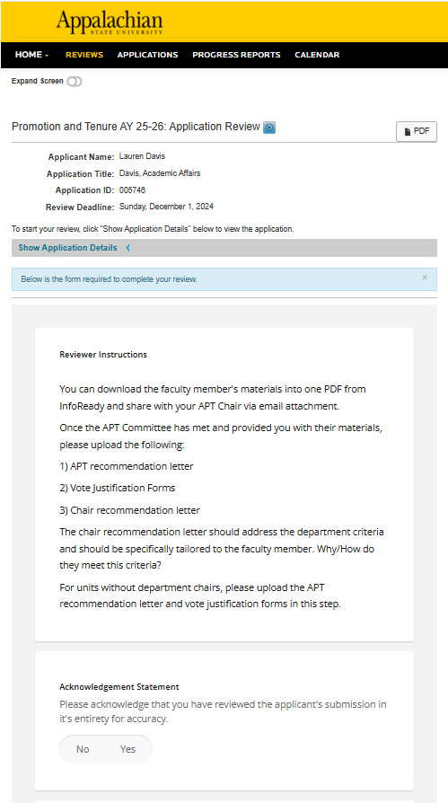
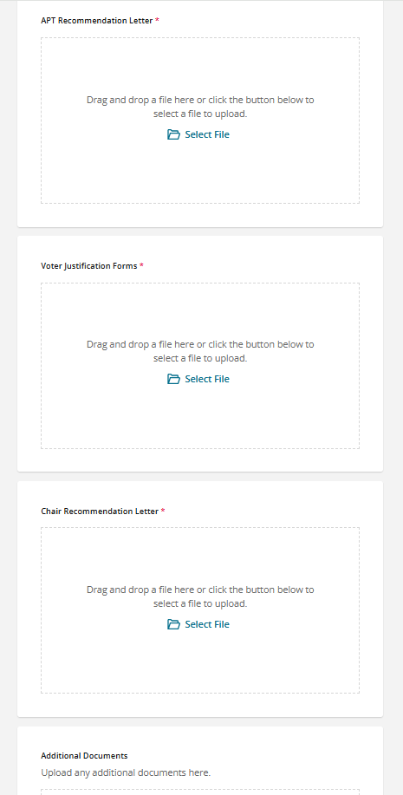
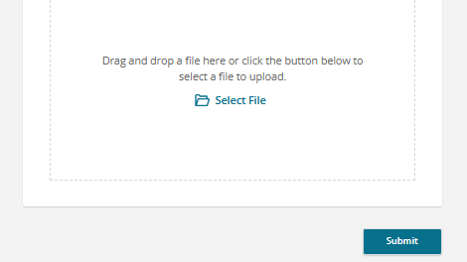
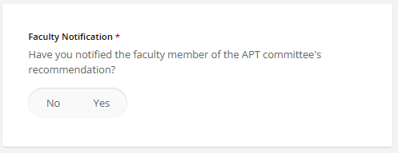
Department Chair
Review Process
Click on PDF button to download the completed application with all additional materials.
Download/Save/Email your faculty members packet to send to your APT Chair. Your APT Chair can then share the document with the APT Committee.

Slide 17
Faculty member submission PDF packet
This video has no audio but it will visualize how the downloaded application packet will be organized.
Notes:
http://drive.google.com/file/d/1ABo0dvum9pDDjP53cbGtqHZSYR0MST_h/view

Slide 18
Department Chair
Review Process
6. The Department Chair will receive the Vote Justification Forms and APT Recommendation letter to review and compile with their recommendation letter to upload to the indicated area ‘Choose File’
7. Click the box to acknowledge the review of the application
8. Select Yes or No if you have notified the applicant of the APT Committee’s recommendation
9. ‘Save as Draft’ or ‘Submit’

Slide 19
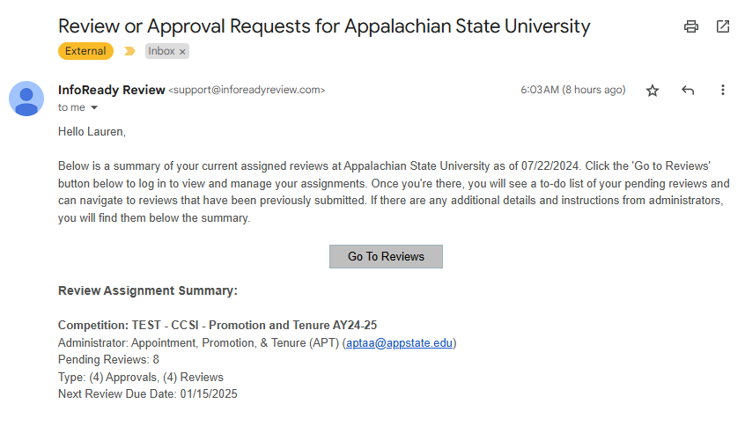
Dean’s Office Administrator and Dean Review Process
Dean’s Office Administrator and Dean Review Process
Similar steps to the department chair review process
Email notification for College Administrator & Dean (left)
You can gain access to your inbox through the email notification or by signing into InfoReady and click ‘Reviews’

Slide 20
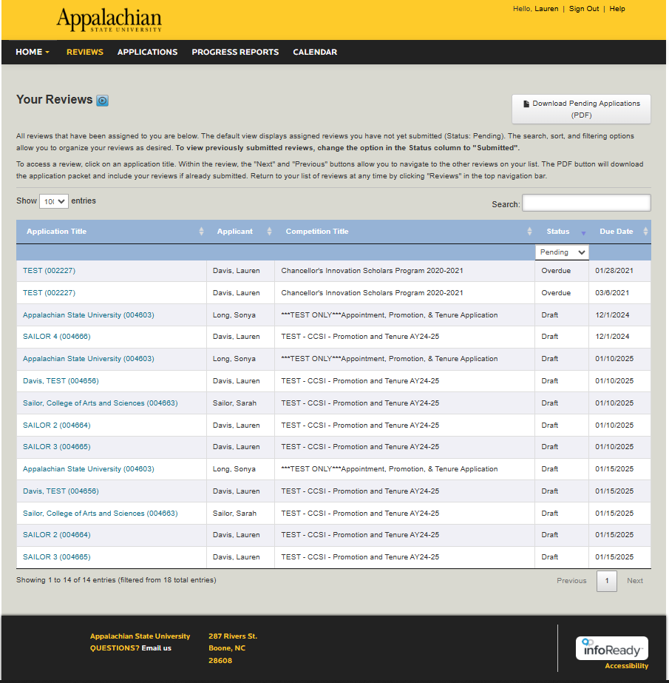
Dean’s Office Administrator and Dean Review Process
Click on the Submission you would like to view.
Do not click on the ‘Download Pending Applications’ button this will download all applicants into one document

Slide 21
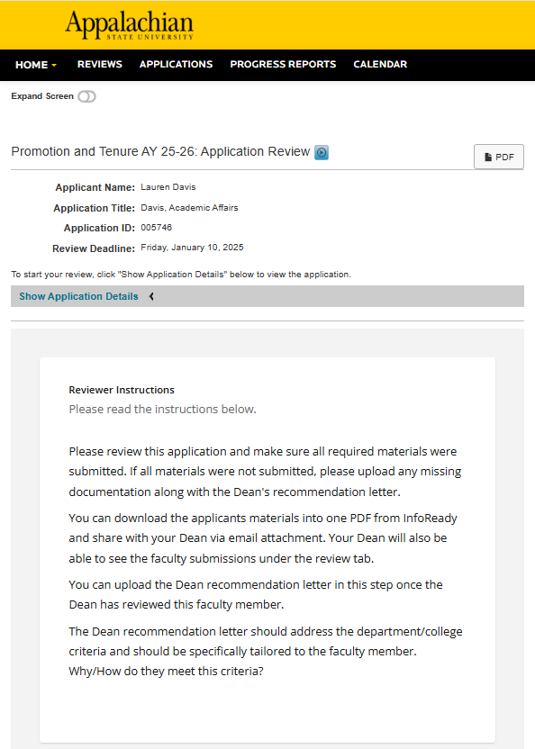
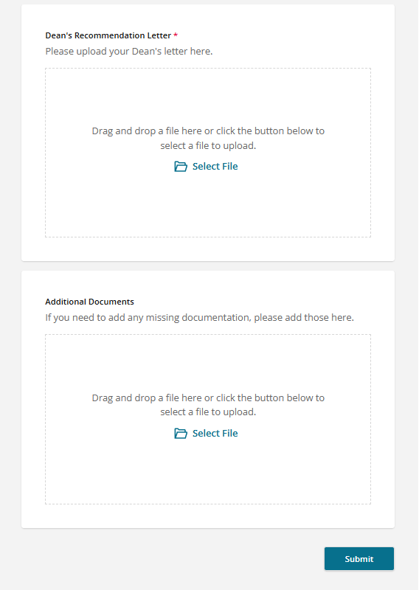
Dean’s Office Administrator Review
You can download the individual packet by clicking the PDF button towards the top of the page. Please review the packet and make sure that all materials have been submitted.
If you need to add materials that were not submitted, please upload them in the ‘Additional Documents’ box. Upload the Dean’s recommendation letter in the indicated area.
Once you have finished all reviews for your college, please submit the ‘Summary of Recommendation/Action Sheet’ to Lauren Davis and the Senior Vice Provost
Either ‘SAVE AS DRAFT’ or ‘SUBMIT’

Slide 22
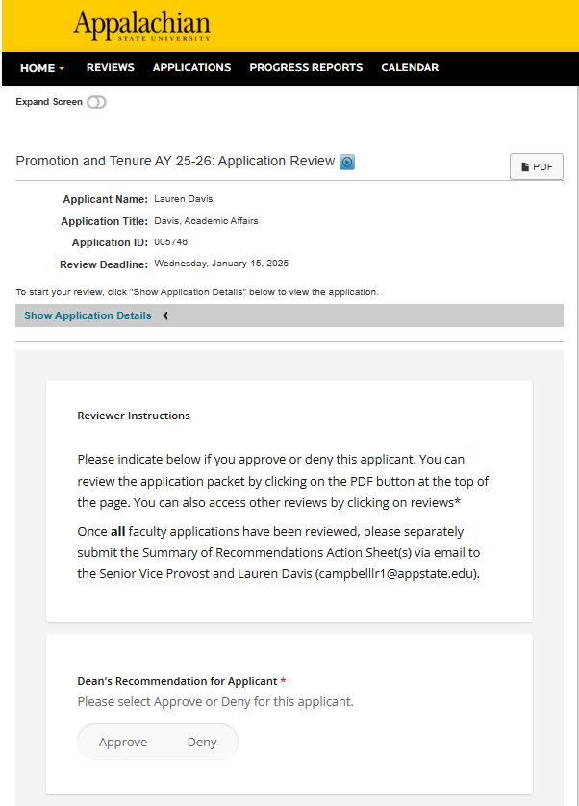
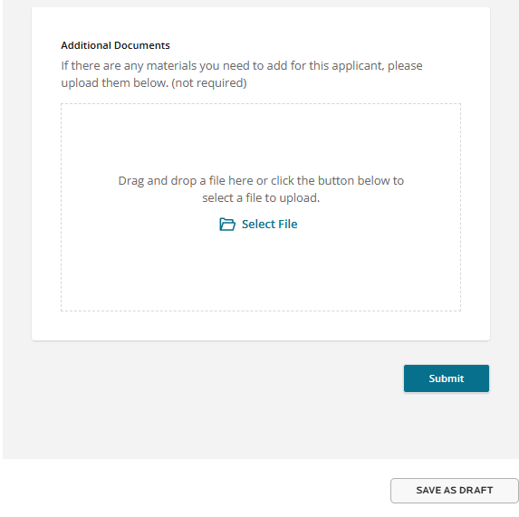
Dean’s Review and Approval
Login and choose submission to review
To your left, is the Dean approval snapshot
Please indicate either ‘Approve’ or ‘Deny’
If you need to add any additional documents, you have the opportunity to do so at this screen
Either ‘SAVE AS DRAFT’ or ‘SUBMIT’

Slide 23
Review Process Continued…
The Senior Vice Provost and Provost review faculty submissions for approval
Approved submissions will be shared with the Chancellor and Board of Trustees (BOT)
BOT vote for approval March 2026
Faculty members are notified of their approval by mail between the end of March - April

Slide 24
Reviewer (Chair/Admin/Dean) Due Dates in InfoReady
These are extended due dates in InfoReady to accommodate varying college guidelines and potential late submissions.
*Please do not wait until the last day to submit your recommendations and materials.
Department Chair: December 1
College Admin: January 10
College Dean: January 15

Slide 25
Additional Resources:
Applicant Guide
Reviewer Guide
Video: Applicant Experience
Video: Reviewer Experience

Slide 26
Contact Information:
Division of Academic Affairs
828-262-2070
aa@appstate.edu
academicaffairs.appstate.edu

