Slide 1
Provost Report,
February Faculty Senate Meeting
Heather Hulburt Norris, Ph.D.
Provost and Executive Vice Chancellor April 8, 2024

Slide 2
Topics
Academic updates related to the Hickory Campus
Faculty salaries
Wey Hall
Emerging LGBTQ+ concerns
Free Expression Space
Expected Board of Governors policy revisions

Slide 3
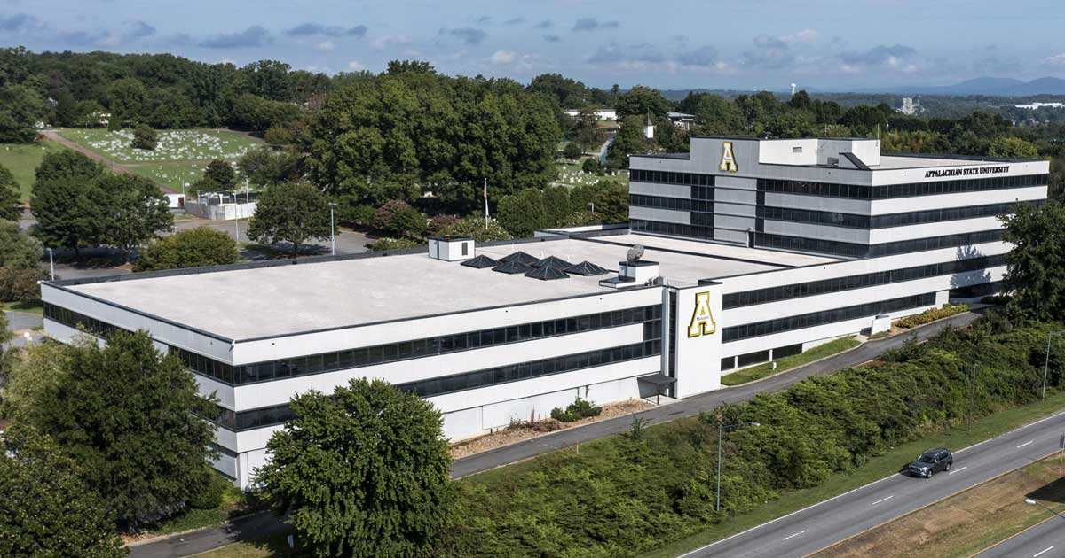
Updates: Hickory Campus

Slide 4
Hickory Campus Successful Programs
Elementary Education
Social Work
Business-related Programs
Criminal Justice
Psychology

Slide 5
Hickory Campus Strong Demand Areas
Communication Studies
Apparel Design & Merchandising
Health Care Professions
Building Solutions-related programs

Slide 6
Hickory Campus Financial Stewardship
Hickory investment is not a detriment to Boone campus resources
State allocations are robust
Continued exploration of cost-effective pedagogies and engagement

Slide 7
Stipends for Teaching Away from Duty Station
Anticipating ability to make adjustments to the pay scale
Compensation for opportunity cost of travel time
Continued information will be provided throughout the budget process

Slide 8
Faculty Salaries
Seeking authority to use internal funds in FY24 for merit increases
Merit pay retroactive to July 1, 2024
Merit increases will augment the 3% increases already appropriated

Slide 9
Wey Hall Update
In-person classes cancelled March 20, building reopened March 25
Contractor failed to follow approved safety protocols
Dean Campbell outreach to all Art Department faculty, staff and students

Slide 10
Notes:
Auxiliary net transfers includes $8.34M of Dining transfers out for capital improvements ($1M Central Dining roof repair, $6.34M All-Access remodel, $1M Retail Outlet remodel) as well as transfers out associated with the annual Auxiliary Overhead assessment.

Slide 11
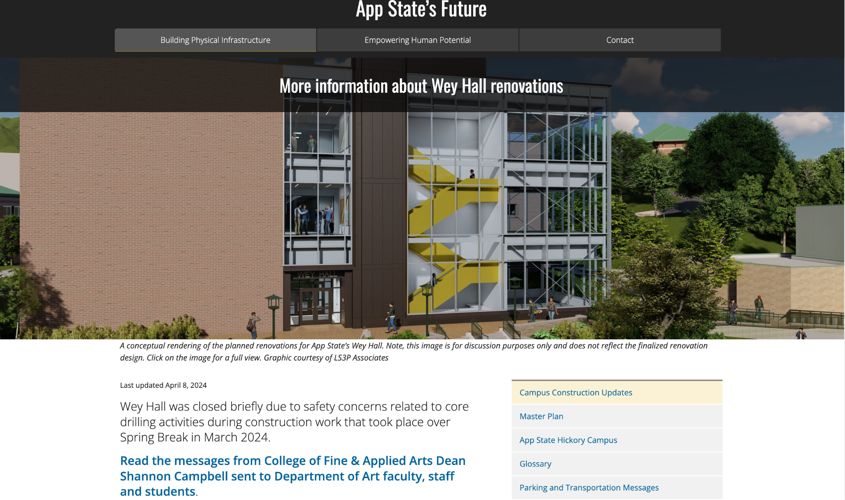
Notes:
Auxiliary net transfers includes $8.34M of Dining transfers out for capital improvements ($1M Central Dining roof repair, $6.34M All-Access remodel, $1M Retail Outlet remodel) as well as transfers out associated with the annual Auxiliary Overhead assessment.

Slide 12
LGBTQ+ Emerging Concerns
No effort to terminate LGBTQ+ employees
App State does not collect or maintain LGBTQ+ status
Any discharged employee is provided information to file a grievance
Faculty who need support may reach out to campus resources
We are continually seeking ways to develop and foster a campus environment in which all members of our university community feel supported and can thrive

Slide 13
Free Expression Space
Vice Chancellor Brown outreach to students
50+ students completed survey
Designated Free Speech Officers Jamie Parson and Jeff Cathey are establishing a group for alternative options for Free Expression Space on campus

Slide 14
SAT/ACT Requirements Discussion
Upcoming BOG meeting will discuss SAT/ACT requirements for undergraduate admissions
Requirement temporarily waived due to COVID-19 in July 2020
Waiver expires after fall 2024 admissions cycle

Slide 15
SAT/ACT Requirements Proposed Revisions
Proposal allows those below GPA threshold to “test into” the UNC System
Campuses my propose testing requirements for higher GPA’s
Proposed changes ensure students are academically prepared
Final solution to allow flexibility in requirements

Slide 16
Thank you!
Campus Budget Presentations
Friday, April 12 8 a.m. to 12:15 p. m.
Grandview Ballroom of the North End Zone Facility
Live stream available at Hickory Campus
Library and Information Commons

